Slide 1

Chopper Amplifier
Launch
Launch
Defination, Operating Principle, Application

Slide 2

Learning Outcomes
After the ending of the lesson students will able to know about
Definition of chopper amplifier
How the chopper amplifier works.
Practical applications of chopper amplifier

Slide 3
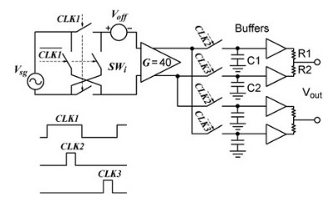
What is chopper amplifier?
The name Chop means to sample the data. The amplifier circuit samples the analog signal. So it is known as chopper amplifier.
It is used to reduce or eliminate dc offset and low-frequency noise in op amps.

Slide 4
Why it is important?
When recording biopotentials noise and drift are the two problems encountered.
Noise is due to the recording device and by the patient when they move.
Drift is a shift in baseline created due to various thermal effects.
A DC amplifier has a shift or sudden peak in the output when the input is zero.
Therefore, a chopper amplifier solves the problems of drift in DC amplifiers

Slide 5
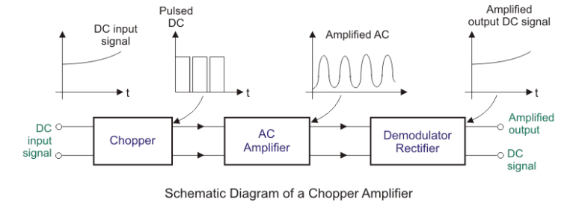
Block Diagram of Chopper Amplifier

Slide 6
Operation Principle:
The first block chopper accepts the DC input signal and converts them to an AC signal.
The AC amplifier block amplifies the chopped AC signal.
The chopper converts DC or low-frequency signal to high-frequency signal.
An AC amplifier amplifies the modulated high-frequency signal.
The amplified signal is demodulated and filtered to obtain the low frequency or DC signal.

Slide 7
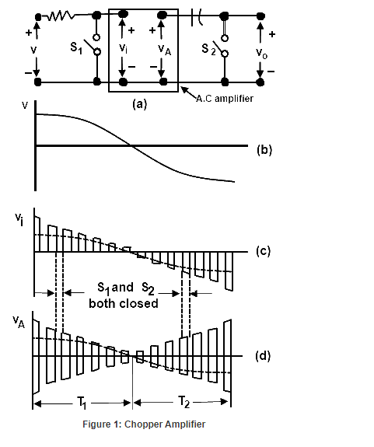
Operation of Chopper amplifier circuit

Slide 8

Thank You
FUNKY TUNES
Launch
Launch
BOFFIN
Jens Martensson
jens@bellowscollege.com

